Slide 1

Python for Business Analytics
FINAL GROUP PROJECT

Slide 2
Consulting Objectives
Market and Sales Performance
Product Portfolio Optimization
Competitive Advantage
Customer Behavior and Segmentation
Supply Chain and Shipping Efficiency

Slide 3
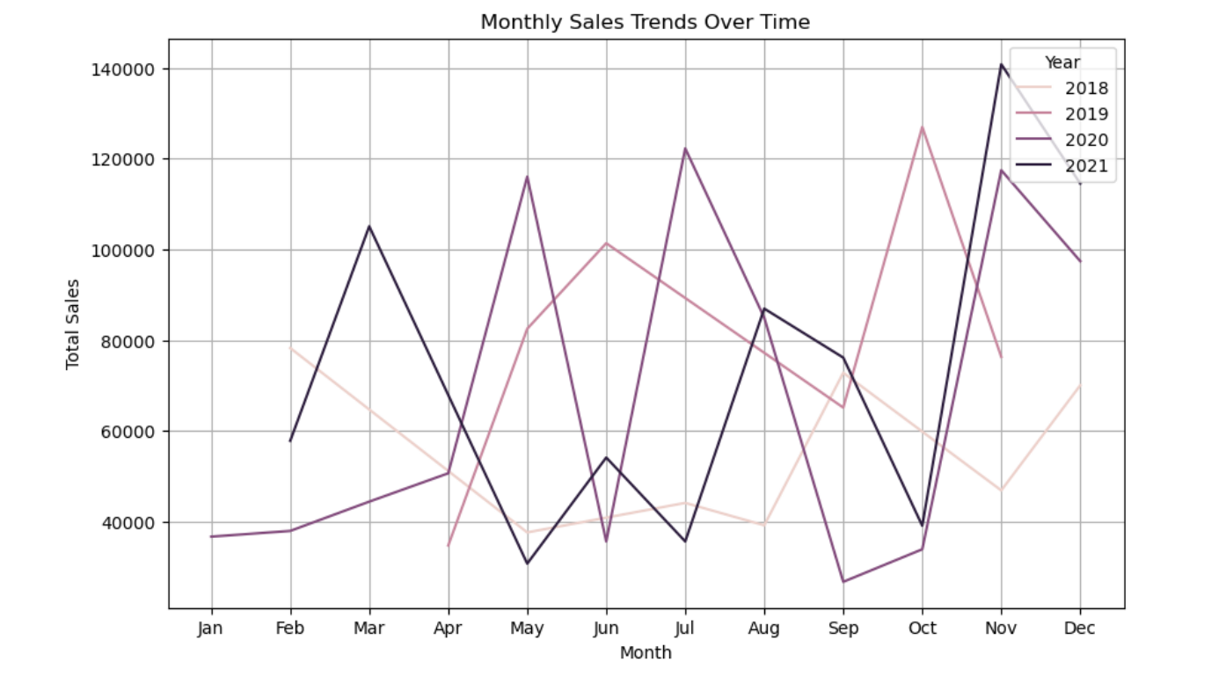
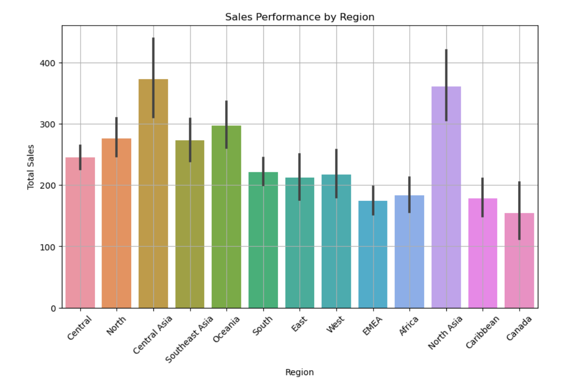
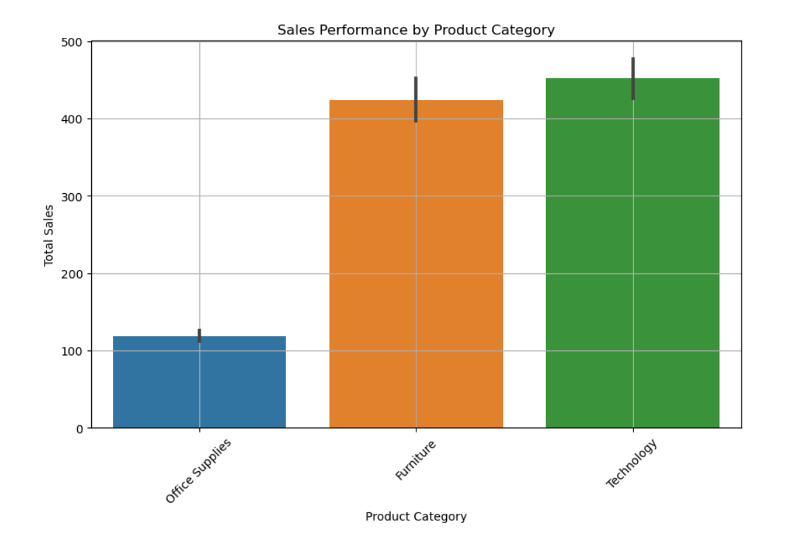
Market and Sales Performance
Customer Behavior and Segmentation
Product Portfolio Optimization
Supply Chain and Shipping Efficiency
Competitive Advantage

Slide 4
Market and Sales Performance
Customer Behavior and Segmentation
Product Portfolio Optimization
Supply Chain and Shipping Efficiency
Competitive Advantage

Slide 5
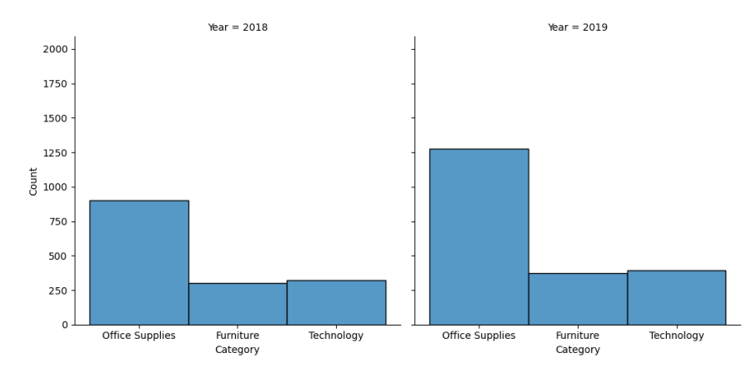
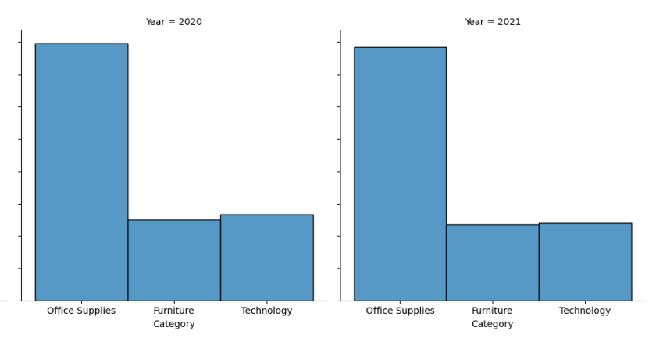
Market and Sales Performance
Customer Behavior and Segmentation
Product Portfolio Optimization
Supply Chain and Shipping Efficiency
Competitive Advantage

Slide 6
Market and Sales Performance
Customer Behavior and Segmentation
Product Portfolio Optimization
Supply Chain and Shipping Efficiency
Competitive Advantage

Slide 7
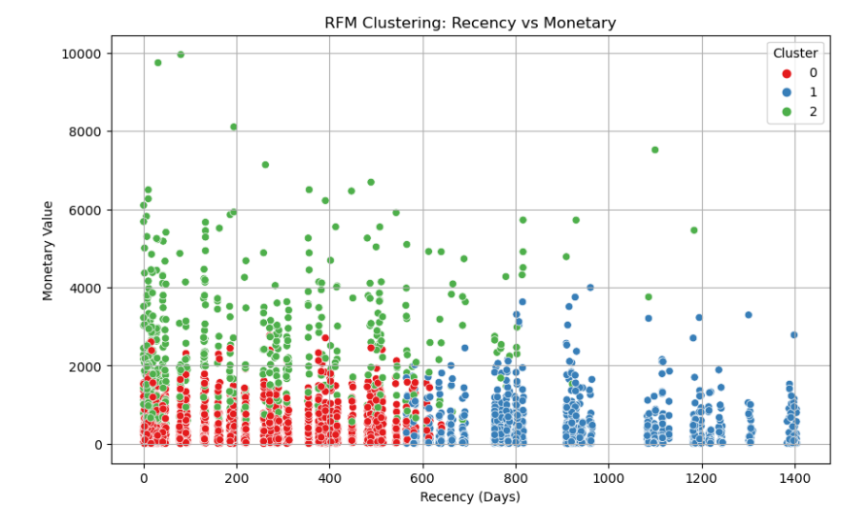
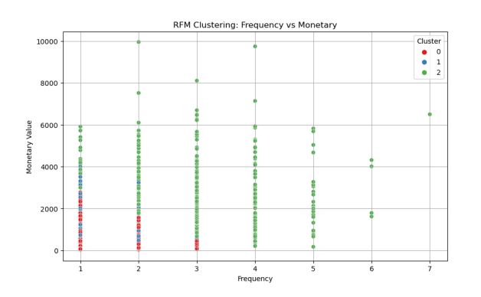
Customer Behavior and Segmentation
Product Portfolio Optimization
Supply Chain and Shipping Efficiency
Competitive Advantage
Market and Sales Performance

Slide 8
Customer Behavior and Segmentation
Product Portfolio Optimization
Supply Chain and Shipping Efficiency
Competitive Advantage
Market and Sales Performance

Slide 9
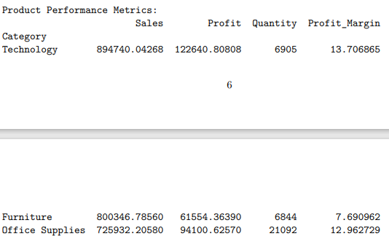
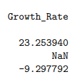
Product Portfolio Optimization
Supply Chain and Shipping Efficiency
Competitive Advantage
Market and Sales Performance
Customer Behavior and Segmentation

Slide 10
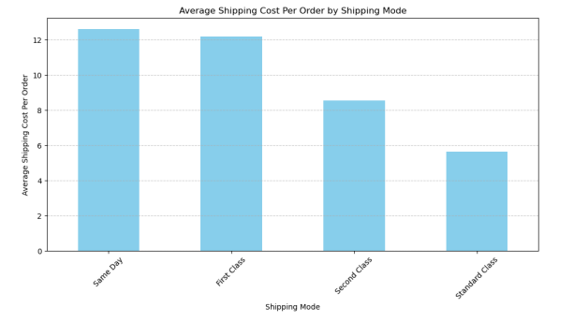
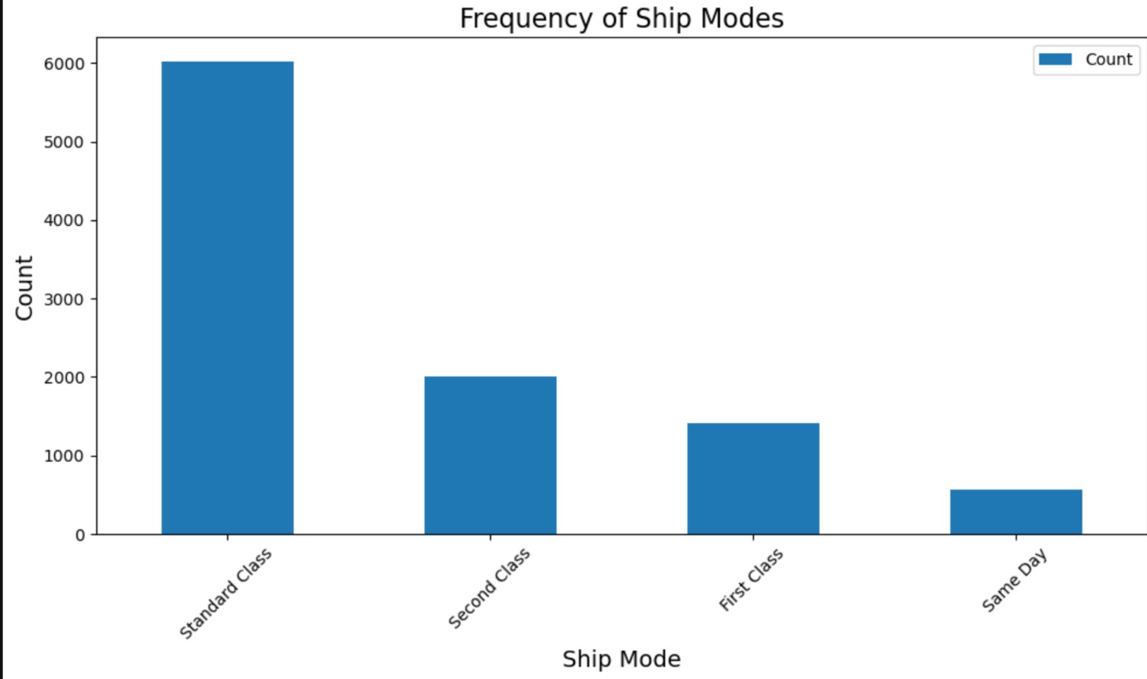
Supply Chain and Shipping Efficiency
Competitive Advantage
Market and Sales Performance
Customer Behavior and Segmentation
Product Portfolio Optimization

Slide 11
Competitive Advantage
Product Diversification
Targeted Marketing Campaigns
Continuous Improvement
Optimizing Shipping Logistics
Enhancing Customer Experiences
Market and Sales Performance
Customer Behavior and Segmentation
Product Portfolio Optimization
Supply Chain and Shipping Efficiency

Slide 12
THANK YOU ☺

